Slide 1
Software Requirements Engineering
Lecture 10
Engr. Sara Rehmat

Slide 2
Finding the voice of user is very important
Success in software requirements, and hence in software development, depends on getting the voice of the user close to the ear of the developer.
Customer involvement is the best way to avoid the expectation gap.
People often talk about “the user” for a software system as though all users belong to a monolithic group with similar characteristics and needs.
In reality, most products of any size appeal to a diversity of users with different expectations and goals, hence we have user classes.

Slide 3
Classifying users
You can group users into a number of distinct user classes based on these sorts of differences:
Their access privilege or security levels (such as ordinary user, guest user, administrator)
The tasks they perform during their business operations
The features they use
The frequency with which they use the product
Their application domain experience and computer systems expertise
The platforms they will be using (desktop PCs, laptop PCs, tablets, smartphones, specialized devices
Their native language
Whether they will interact with the system directly or indirectly

Slide 4
Classifying users on basis of their importance
Favored User Classes, Disfavored User Classes, Ignored User Classes
Certain user classes could be more important than others for a specific project.
Favored user classes are those whose satisfaction is most closely aligned with achieving the project’s business objectives.
When resolving conflicts between requirements from different user classes or making priority decisions, favored user classes receive preferential treatment.
This doesn’t mean that the customers who are paying for the system (who might not be users at all) or those who have the most political clout should necessarily be favored. It’s a matter of alignment with the business objectives.

Slide 5
Classifying users on basis of their importance
Disfavored user classes are groups who aren’t supposed to use the product for legal, security, or safety reasons.
You might build in features to deliberately make it hard for disfavored users to do things they aren’t supposed to do.
Examples include access security mechanisms, user privilege levels, antimalware features (for non-human users), and usage logging. Locking a user’s account after four unsuccessful login attempts protects against access by the disfavored user class of “user impersonators,” albeit at the risk of inconveniencing forgetful legitimate users.
If the user’s bank doesn’t recognize the computer they are using, it sends them an email message with a one-time access code they have to enter before I can log on. This feature was implemented because of the disfavored user class of “people who might have stolen the user’s banking information.”
You might elect to ignore still other user classes.
The ignored user class will use the product, but you don’t specifically build it to suit them.
If there are any other groups of users that are neither favored, disfavored, nor ignored, they are of equal importance in defining the product’s requirements.

Slide 6
Identifying user classes
The external entities shown outside your system on a context diagram are candidates for user classes.
A corporate organization chart can also help you discover potential users and other stakeholders.
Organization chart analysis reduces the likelihood that you will overlook an important class of users within that organization.
It shows you where to seek potential representatives for specific user classes, as well as helping determine who the key requirements decision makers might be.
You might find multiple user classes with diverse needs within a single department. Conversely, recognizing the same user class in multiple departments can simplify requirements elicitation.
Also try to understand what type of information the users from each department might supply based on their role in the organization and their department’s perspective on the project.

Slide 7
Organization chart of Chemical Tracking System

Slide 8
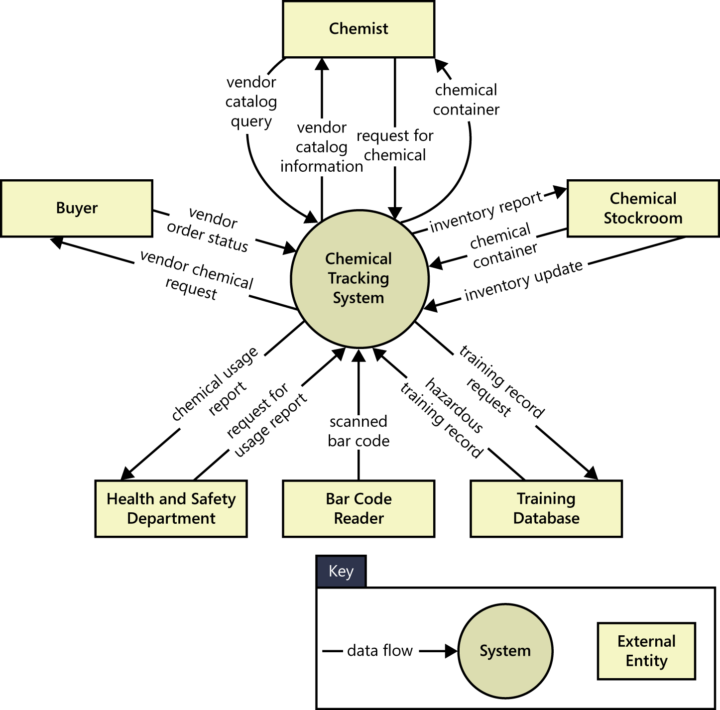

Slide 9
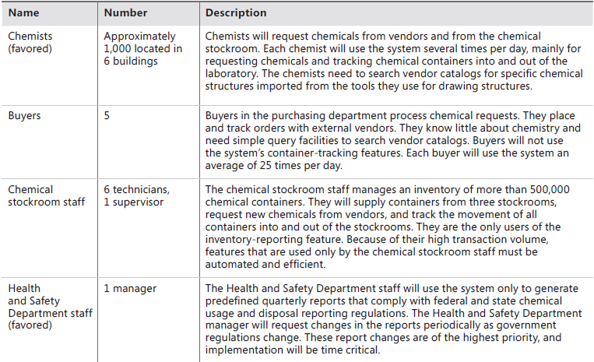
User classes of Chemical Tracking Systems

Slide 10
User personas
To help bring your user classes to life, consider creating a persona for each one.
A persona is a description of a hypothetical, generic person who serves as a stand-in for a user class.
A persona can serve as a placeholder when the BA doesn’t have an actual user representative at hand.
You can use personas to help you understand the requirements and to design the user experience to best meet the needs of specific user communities.
Provided you’ve created a persona that accurately represents the user class, this should help you do a good job of satisfying the needs and expectations of the whole class.

Slide 11
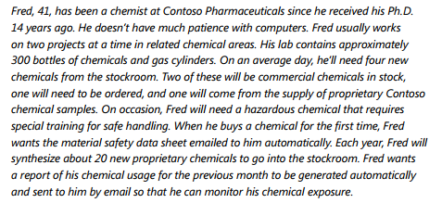
Example of User Persona

Slide 12
Connecting with user representatives
Each user class needs someone to speak for it.
It’s easiest to gain access to actual users when you’re developing applications for deployment within your own company.
If you’re developing commercial software, you might engage people from your beta-testing or early-release sites to provide requirements input much earlier in the development process.
Consider setting up focus groups of current users of your products or your competitors’ products. Instead of just guessing at what your users might want, ask some of them.

Slide 13
Connecting with user representatives
Consider setting up focus groups of current users of your products or your competitors’ products.
Instead of just guessing at what your users might want, ask some of them. Include both expert and less experienced customers.
The most direct communication occurs when developers can talk to appropriate users themselves, which means that the developer is also performing the business analyst role.
This can work on very small projects, provided the developer involved has the appropriate BA skills, but it doesn’t scale up to large projects with thousands of potential users and dozens of developers.

Slide 15
Connecting with user representatives
Intervening layers between the user and the developer increase the chance of miscommunication and delay transmission.
Some of these intervening layers add value, though, as when a skilled BA works with users or other participants to collect, evaluate, refine, and organize their input.
Recognize the risks that you assume by using marketing staff, product managers, subject matter experts, or others as surrogates for the actual voice of the user.
Despite the obstacles to—and the cost of—optimizing user representation, your product and your customers will suffer if you don’t talk to the people who can provide the best information.

Slide 16
The product champion
Each product champion serves as the primary interface between members of a single user class and the project’s business analyst.
Ideally, the champions will be actual users, not surrogates such as funding sponsors, marketing staff, user managers, or software developers imagining themselves to be users.
Product champions gather requirements from other members of the user classes they represent and reconcile inconsistencies.
Requirements development is thus a shared responsibility of the BA and selected users, although the BA should actually write the requirements documents.

Slide 17
The product champion
The best product champions have a clear vision of the new system.
They’re enthusiastic because they see how it will benefit them and their peers.
Champions should be effective communicators who are respected by their colleagues.
We have found that good product champions made a huge difference in our projects, so we offer them public reward and recognition for their contributions.

Slide 18
External product champions
When developing commercial software, it can be difficult to find product champions from outside your company.
Companies that develop commercial products sometimes rely on internal subject matter experts or outside consultants to serve as surrogates for actual users, who might be unknown or difficult to engage.
You might give external product champions economic incentives for their participation.
Consider offering them discounts on the product or paying for the time they spend working with you on requirements.
If you have a diverse customer base, first identify core requirements that are common to all customers. Then define additional requirements that are specific to individual corporate customers, market segments, or user classes.

Slide 19
Examples
One company that developed a retail point-of-sale and back-office system for a particular industry hired three store managers to serve as full-time product champions.
A doctor (the author’s family doctor) named Art, left his medical practice to become the voice-of-the-physician at a medical software company. Art’s new employer believed that it was worth the expense to hire a doctor to help the company build software that other doctors would accept.
A third company hired several former employees from one of their major customers
Rather than bringing in product champions from the customers, the developing company sent BAs to the customer sites. Customers willingly dedicated some of their staff time to helping the BAs get the right requirements for the new invoicing system.
Anytime the product champion is a former or simulated user, watch out for disconnects between the champion’s perceptions and the current needs of real users. Some domains change rapidly, whereas others are more stable.

Slide 20
Product champion expectations
To help the product champions succeed, document what you expect your champions to do.

Slide 21
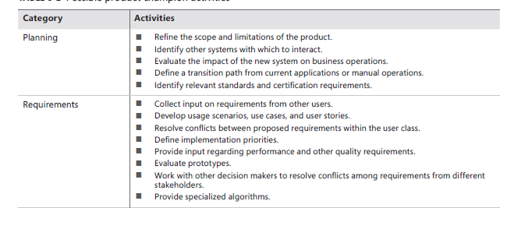
Product champion expectations

Slide 22
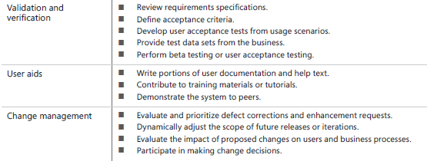
Product champion expectations

Slide 23
Multiple product champions
One person can rarely describe the needs for all users of an application.
The Chemical Tracking System had four major user classes, so it needed four product champions selected from the internal user community at Contoso Pharmaceuticals.

Slide 24
Product champion model for the Chemical Tracking System.

Slide 25
Selling the product champion idea
Expect to encounter resistance when you propose the idea of having product champions on your projects.
“The users are too busy.”
“Management wants to make the decisions.”
“They’ll slow us down.”
“We can’t afford it.”
“They’ll run amok and scope will explode.”
“I don’t know what I’m supposed to do as a product champion.”
Some users won’t want to cooperate on a project that will make them change how they work or might even threaten their jobs.
Managers are sometimes reluctant to delegate authority for requirements to ordinary users.

Slide 26
Selling the product champion idea
Separating business requirements from user requirements alleviates some of these discomforts.
As an actual user, the product champion makes decisions at the user requirements level within the scope boundaries imposed by the business requirements.
The management sponsor retains the authority to make decisions that affect the product vision, project scope, business-related priorities, schedule, or budget.
Documenting and negotiating each product champion’s role and responsibilities give candidate champions a comfort level about what they’re being asked to do.
Remind management that a product champion is a key contributor who can help the project achieve its business objectives.
If you encounter resistance, point out that insufficient user involvement is a leading cause of software project failure.

Slide 27
Product champion traps to avoid
Managers override the decisions that a qualified and duly authorized product champion makesThis behavior often results in dissatisfied users and frustrated product champions who feel that management doesn’t trust them.
A product champion who forgets that he is representing other customers and presents only his own requirements won’t do a good job. He might be happy with the outcome, but others likely won’t be.
A product champion who lacks a clear vision of the new system might defer decisions to the BA. If all of the BA’s ideas are fine with the champion, the champion isn’t providing much help.
A senior user might nominate a less experienced user as champion because she doesn’t have time to do the job herself. This can lead to backseat driving from the senior user who still wishes to strongly influence the project’s direction.

Slide 28
User representation on agile projects
Frequent conversations between project team members and appropriate customers are the most effective way to resolve many requirements issues and to flesh out requirements specifics when they are needed.
Written documentation, however detailed, is an incomplete substitute for these ongoing communications.
A fundamental tenet of Extreme Programming, one of the early agile development methods, is the presence of a full-time, on-site customer for these discussions.

Slide 29
User representation on agile projects
Some agile development methods include a single representative of stakeholders called a product owner in the team to serve as the voice of the customer.
The product owner defines the product’s vision and is responsible for developing and prioritizing the contents of the product backlog.
The backlog is the prioritized list of user stories—requirements—for the product and their allocation to upcoming iterations, called sprints in the agile development method called Scrum.
The product owner therefore spans all three levels of requirements: business, user, and functional.
He essentially straddles the product champion and business analyst functions, representing the customer, defining product features, prioritizing them, and so forth.
“On-sight” customer

Slide 30
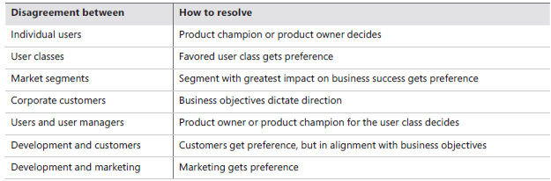
Resolving conflicting requirements

Slide 31
Classifying customer input
Don’t expect your customers to present a succinct, complete, and well-organized list of their needs.
Analysts must classify the myriad bits of requirements information they hear into various categories so that they can document and use it appropriately.

Slide 32
Requirements other than mentioned classes
As with many categorizations, the information gathered might not fit precisely into these nine buckets.
Anything that doesn’t fit into one of these categories might be:
A project requirement not related to the software development, such as the need to train users on the new system.
A project constraint, such as a cost or schedule restriction (as opposed to the design or implementation constraints described in this chapter).
An assumption or a dependency.
Extraneous information that does not add value.

Slide 33
Business requirements
Anything that describes the financial, marketplace, or other business benefit that either customers or the developing organization wish to gain from the product is a business requirement.
Listen for statements about the value that buyers or users of the software will receive, such as these:
“Increase market share in region X by Y percent within Z months.”
“Save $X per year on electricity now wasted by inefficient units.”

Slide 34
User requirements
General statements of user goals or business tasks that users need to perform are user requirements, most typically represented as use cases, scenarios, or user stories
A user who says, “I need to <do something>” is probably describing a user requirement, as in the following examples:
“I need to print a mailing label for a package.”
“As the lead machine operator, I need to calibrate the pump controller first thing every morning.”

Slide 35
Business rules
When a customer says that only certain users can perform an activity under specific conditions, he might be presenting a business rule.
These aren’t software requirements as they stand, but you might derive some functional requirements to enforce the rules. Phrases such as “Must comply with . . . ,” “If <some condition is true>, then <something happens>,” or “Must be calculated according to . . . ” suggest that the user is describing a business rule. Here are some examples:
“A new client must pay 30 percent of the estimated consulting fee and travel expenses in advance.”
“Time-off approvals must comply with the company’s HR vacation policy.”

Slide 36
Functional requirements
Functional requirements describe the observable behaviors the system will exhibit under certain conditions and the actions the system will let users take.
Here are some examples of functional requirements as you might hear them from users:
“If the pressure exceeds 40.0 psi, the high-pressure warning light should come on.”
“The user must be able to sort the project list in forward and reverse alphabetical order.”
These statements illustrate how users typically present functional requirements, but they don’t represent good ways to write functional requirements.
The

Slide 37
Quality attributes
Statements that describe how well the system does something are quality .
Listen for words that describe desirable system characteristics: fast, easy, user-friendly, reliable, secure.
You’ll need to work with the users to understand just what they mean by these ambiguous and subjective terms so that you can write clear, verifiable quality goals.
The following examples suggest what quality attributes might sound like when described by users:
“The mobile software must respond quickly to touch commands.”
“The shopping cart mechanism has to be simple to use so my new customers don’t abandon the purchase.”

Slide 38
External interface requirements
Requirements in this category describe the connections between your system and the rest of the universe.
Phrases such as “Must read signals from . . . ,” “Must send messages to . . . ,” “Must be able to read files in <format>,” and “User interface elements must conform to <a standard>” indicate that the customer is describing an external interface requirement.
Following are some examples:
“The manufacturing execution system must control the wafer sorter.”
“The mobile app should send the check image to the bank after I photograph the check I’m depositing.”

Slide 39
Constraints
Design and implementation constraints legitimately restrict the options available to the developer.
Devices with embedded software often must respect physical constraints such as size, weight, and interface connections.
Phrases that indicate that the customer is describing a design or implementation constraint include: “Must be written in <a specific programming language>,” “Cannot exceed <some limit>,” and “Must use <a specific user interface control>.”
The following are examples of constraints that a customer might present:
“Files submitted electronically cannot exceed 10 MB in size.”
“The browser must use 256-bit encryption for all secure transactions.”
Ask why the constraint exists, confirm its validity, and record the rationale for including it as a requirement.

Slide 40
Data requirements
Customers are presenting a data requirement whenever they describe the format, data type, allowed values, or default value for a data element; the composition of a complex business data structure; or a report to be generated.
Some examples of data requirements are as follows:
“The ZIP code has five digits, followed by an optional hyphen and four digits that default to 0000.”
“An order consists of the customer’s identity, shipping information, and one or more products, each of which includes the product number, number of units, unit price, and total price.”

Slide 41
Solution ideas
Many “requirements” from users are really solution ideas.
Someone who describes a specific way to interact with the system to perform some action is suggesting a solution.
The business analyst needs to probe below the surface of a solution idea to get to the real requirement.
Repeatedly asking “why” the user needs it to work this way will likely reveal the true need.
For instance, passwords are just one of several possible ways to implement a security requirement.
“Then I select the state where I want to send the package from a drop-down list.”
The prudent BA will ask, “Why from a drop-down list?” If the user replies, “That just seemed like a good way to do it,” then the real requirement is something like, “The system shall permit the user to specify the state where he wants to send the package.”
But maybe the user says, “We do the same thing in several other places and I want it to be consistent. Also, the drop-down list prevents the user from entering invalid data.”
These are legitimate reasons to specify a specific solution.
Recognize, though, that embedding a solution in a requirement imposes a design constraint on that requirement: it limits the requirement to being implemented in only one way. This isn’t necessarily wrong or bad; just make sure the constraint is there for a good reason.

Slide 42
How to tell that elicitation is over
No simple signal will indicate when you’ve completed requirements elicitation.
Perhaps you are done if:
The users can’t think of any more use cases or user stories. Users propose new scenarios, but they don’t lead to any new functional requirements. A “new” use case might really be an alternative flow for a use case you’ve already captured.
Users repeat issues they already covered in previous discussions.
Suggested new features, user requirements, or functional requirements are all deemed to be out of scope.
The users are proposing capabilities that might be included “sometime in the lifetime of the product” rather than “in the specific product we’re talking about right now.”
Developers and testers who review the requirements for an area raise few questions.

Slide 43
Some cautions about elicitation
Balance stakeholder representation
Define scope appropriately
Avoid the requirements-versus-design argument
Research within reason
Assumed and implied requirements

